Slide 1



Air Quality Index (AQI) Monitoring & Prediction
Project by –Tanu Verma

Slide 2

Learning Objectives
Understand the impact of air pollution on health and environment
Automate AQI classification using Machine Learning
Build an end-to-end ML pipeline: Data → Model → Deployment
Deploy the model for real-world predictions (Flask / Streamlit)
GOAL
Source :
www.freepik.com/

Slide 3
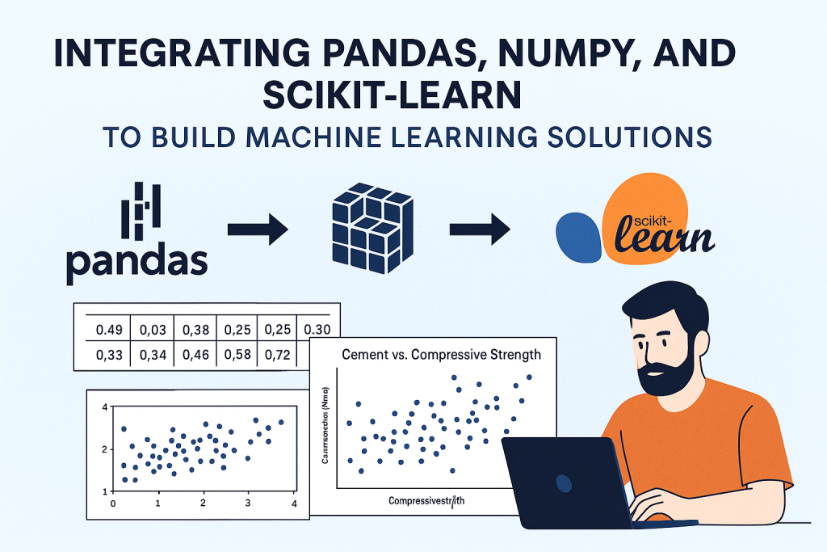
Tools and Technology used
Python, Pandas, NumPy, Scikit-learn
RandomForestClassifier for AQI bucket prediction
Matplotlib & Seaborn for data visualization
Flask API & Streamlit for deployment
Heroku / Streamlit Cloud for hosting

Slide 4
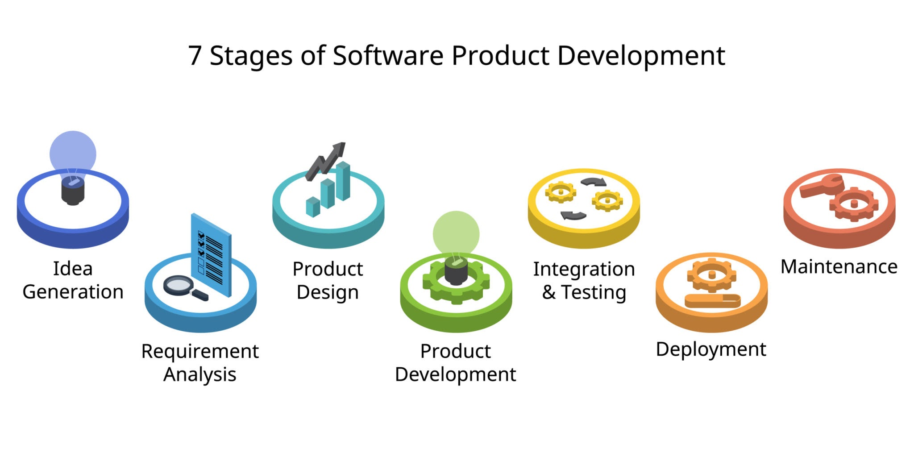
Methodology
Data Collection & Preprocessing
Feature Engineering (Date extraction, Encoding, Scaling)
Model Training (RandomForestClassifier)
Model Evaluation (Accuracy, Confusion Matrix, Classification Report)
Save trained artifacts as .pkl files
Deploy using Flask API & Streamlit UI

Slide 5
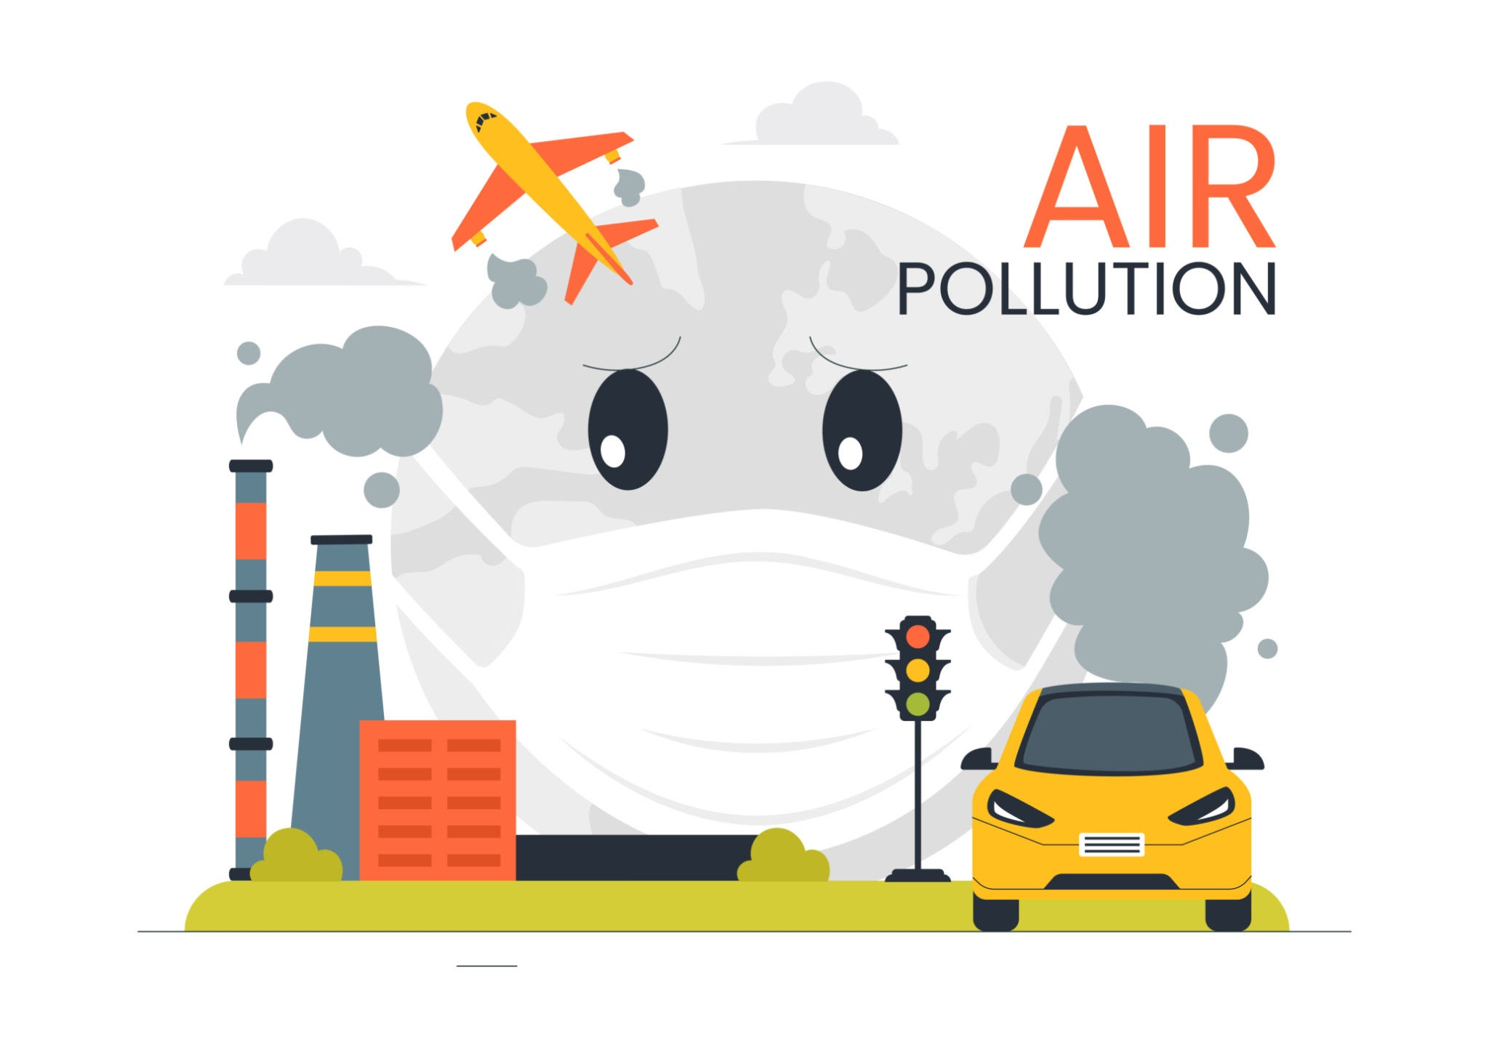
Problem Statement:
Rising air pollution levels cause severe health hazards
Lack of accessible, real-time AQI prediction tools
Manual AQI classification methods are inefficient and slow

Slide 6
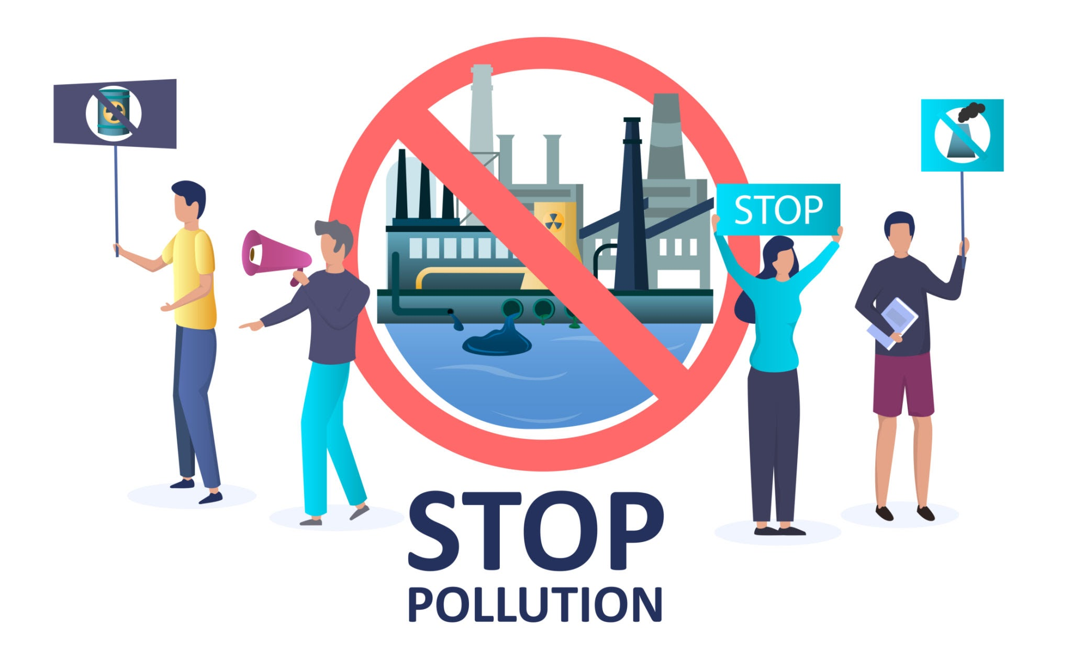
Solution:
Develop an ML model to classify AQI buckets accurately
Build an automated pipeline for preprocessing & prediction
Deploy as a web application (Flask / Streamlit) for easy access
Provide a scalable solution for real-time AQI monitoring

Slide 7
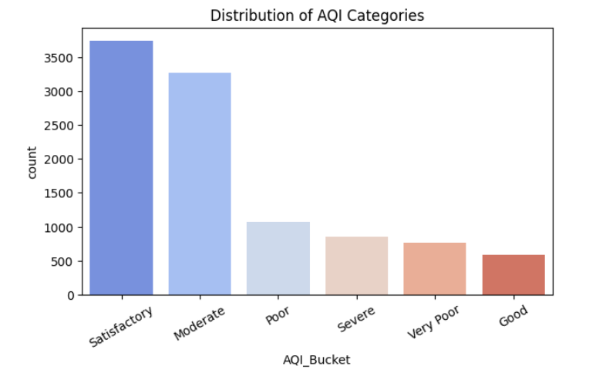
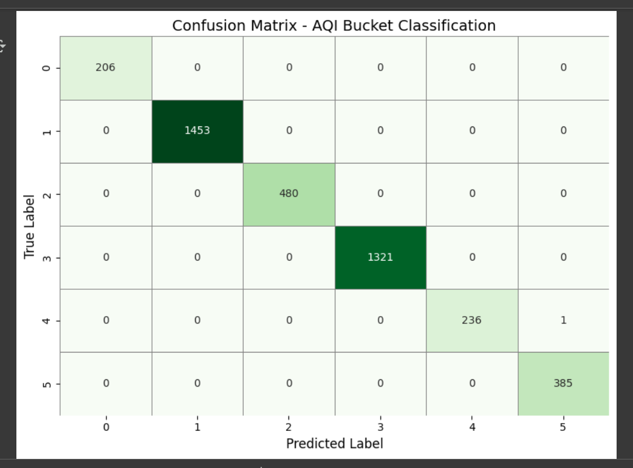
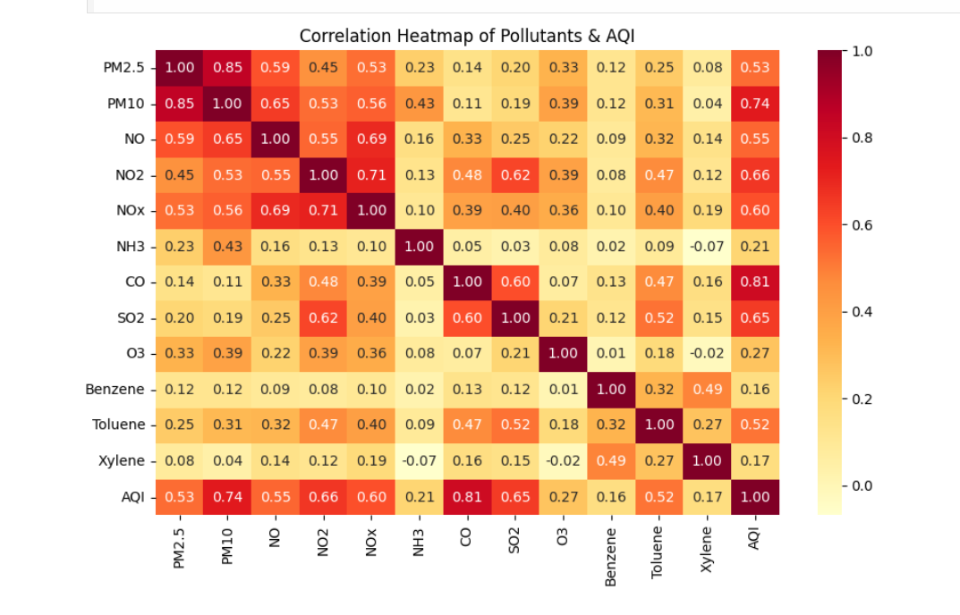
Screenshot of Output:

Slide 8
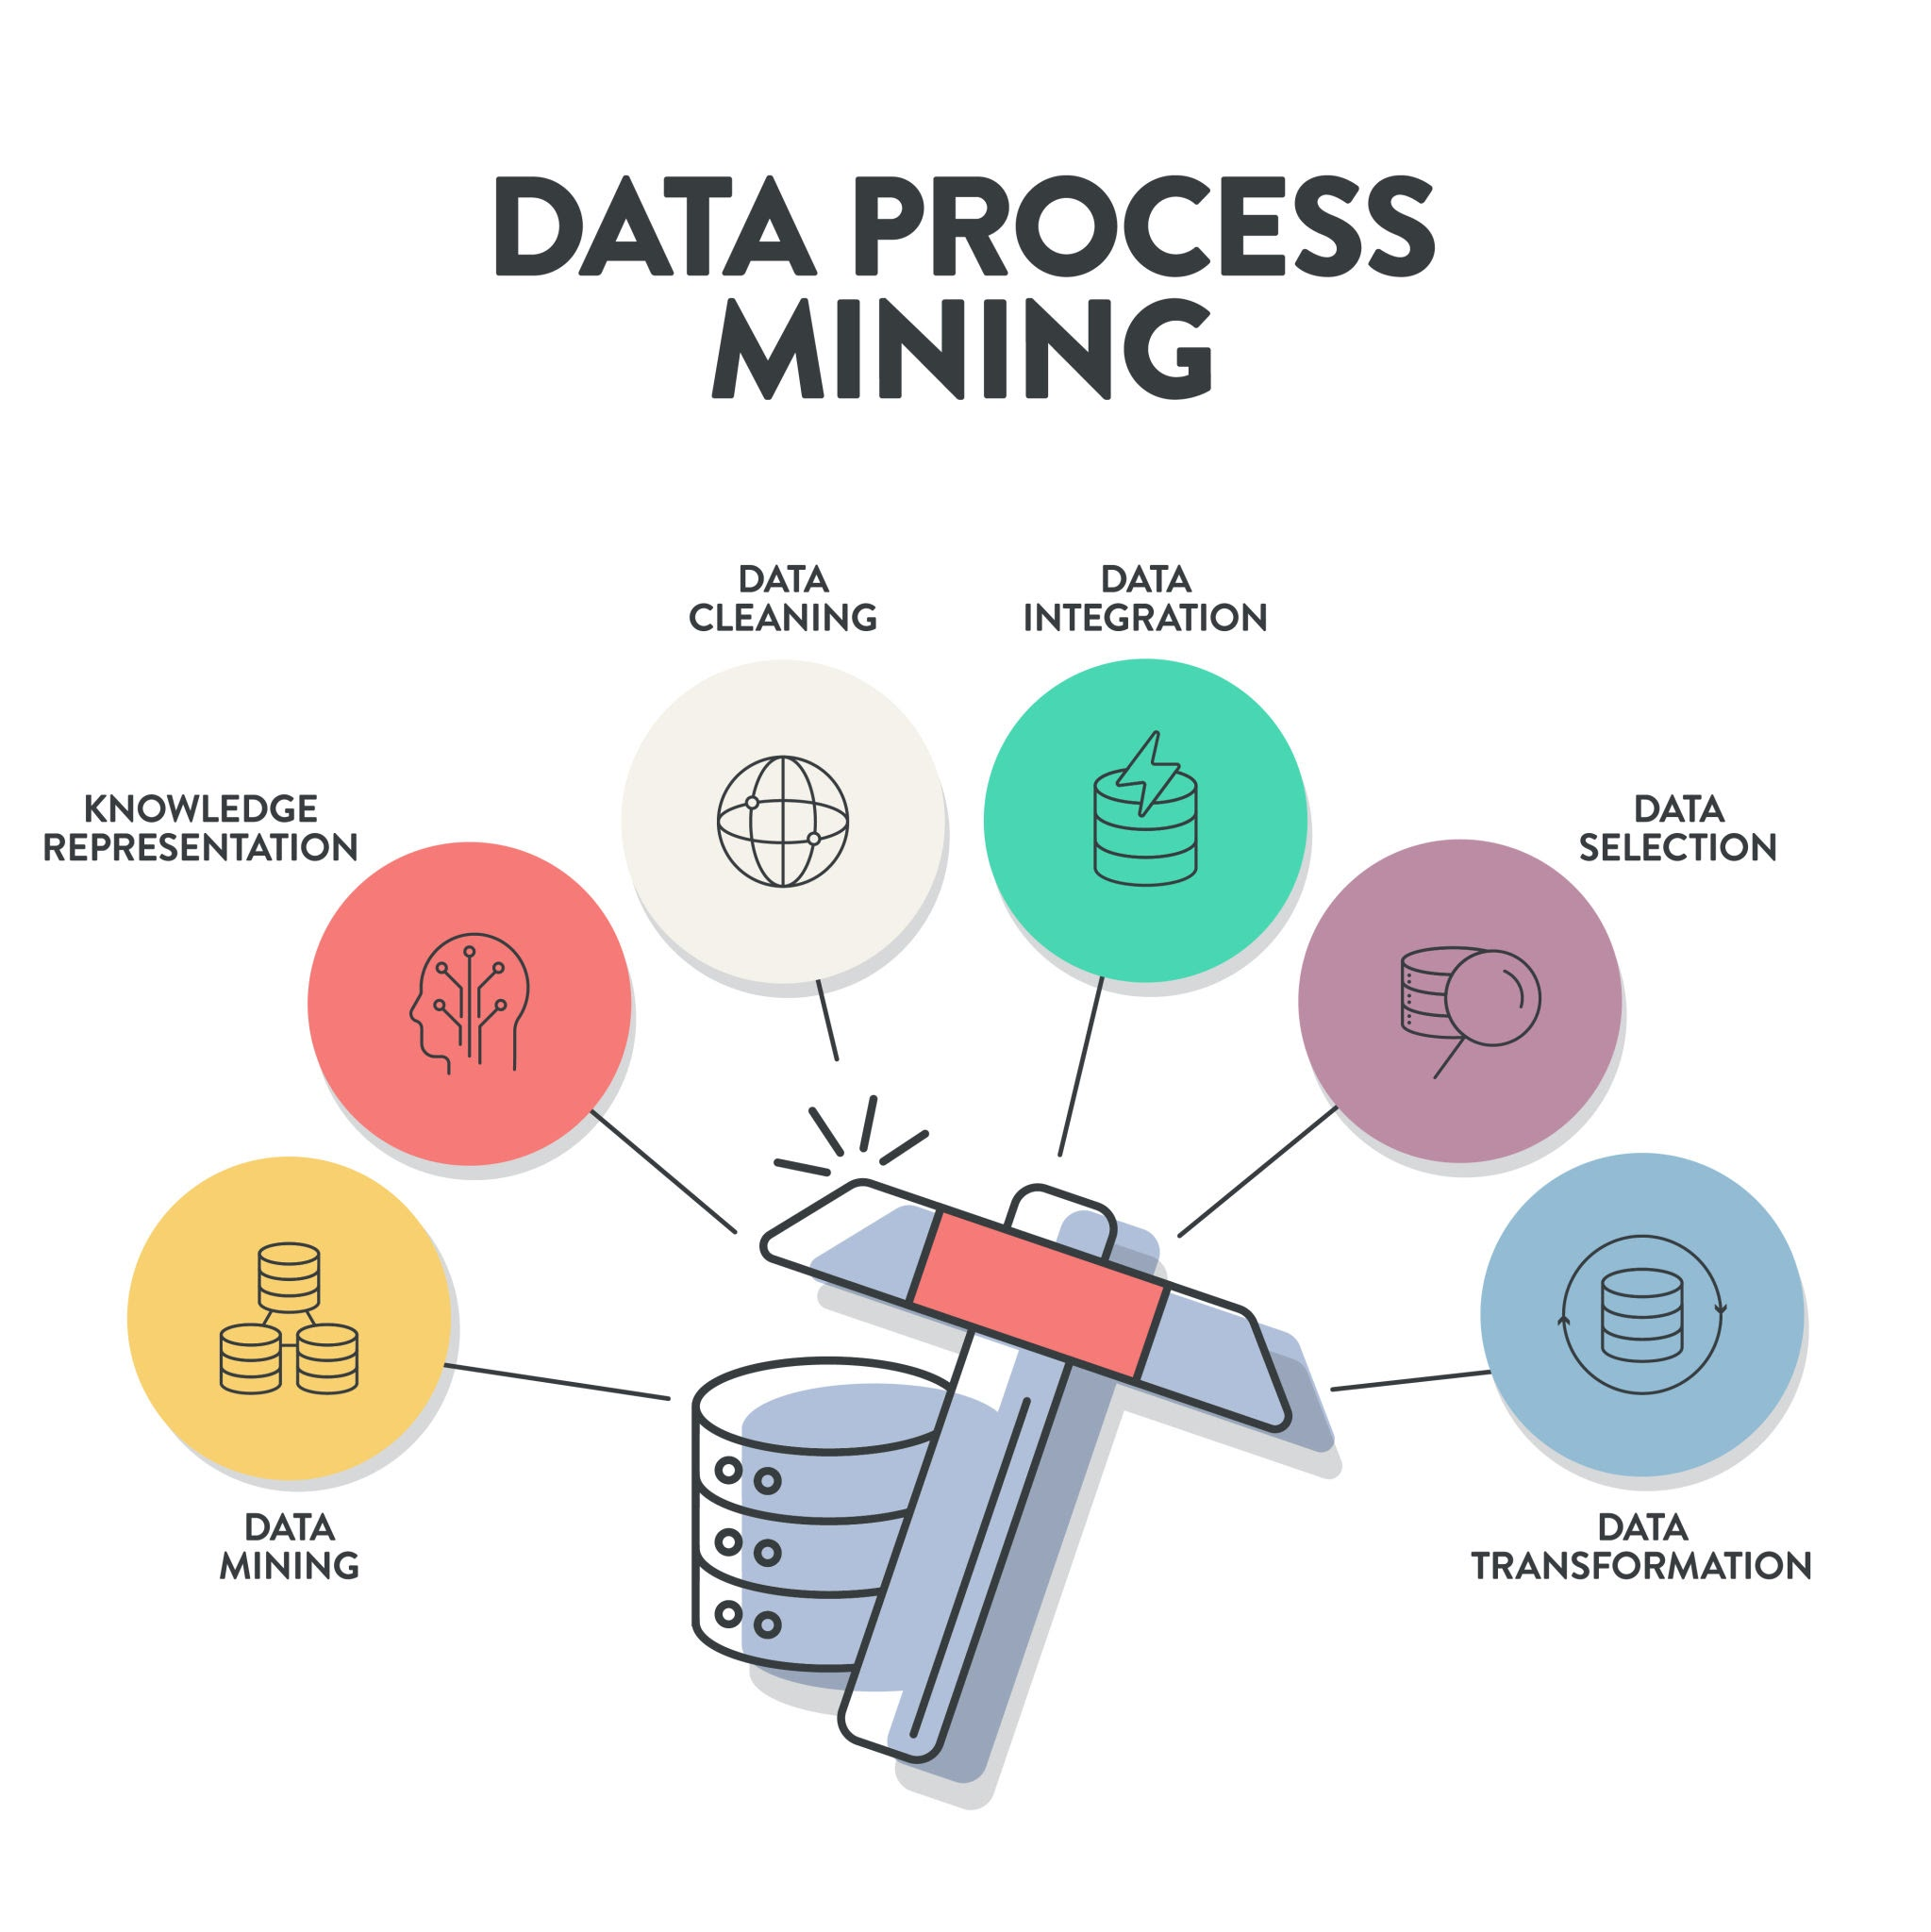
Conclusion:
Built an end-to-end AQI ML pipeline
Achieved high accuracy with RandomForest model
Successfully deployed the model for real-world predictions
Scalable solution, ready for real-time AQI monitoring

Slide 9


